Slide 1
Analysis of Update Types on Player Retention Across Games
Examining the Impact of Major, Content, Balance, and Bug Fix Updates on Player Engagement in Isle, Ark, and Noman

Slide 2
Introduction
Project Overview:
Objective: Utilize data science techniques to analyze the impact of large game updates on player retention and activity levels across three popular games: The Isle, ARK: Survival Evolved, and No Man's Sky. This analysis will provide insights into how different types of updates influence player engagement and help optimize update strategies.
Scope and Purpose:
Data Field: Gaming
Data Types:
Player count data over time
Game update logs
User reviews related to update time

Slide 3
Key Questions to Explore:
General Impact of Updates on Player Retention:
How do major updates affect player counts in the days and weeks following their release?
Is there a noticeable increase or decrease in player retention immediately after an update?
Frequency of Updates and Player Activity:
How does the frequency of updates (e.g., monthly vs. quarterly) impact player retention and activity levels?
Are more frequent updates associated with higher or lower player engagement between updates?
Types of Updates and Their Effectiveness:
Do updates that introduce new content have a more significant impact on player retention compared to bug fixes or balance changes?
How do different types of updates affect long-term player engagement?
Comparative Analysis Across Multiple Games:
How do player retention trends following updates compare between The Isle, ARK: Survival Evolved, and No Man's Sky?
Are there differences in how frequent or less frequent updates affect player counts across these games?
Purpose:
To provide actionable insights for game developers on optimizing update strategies to enhance player engagement and retention.

Slide 4
2) Data Prepration
1. Data Collection:
Sources:
Game logs and update records
Player count statistics over time
User reviews and feedback
2. Data Cleaning:
Handling Missing Values:
Removed or imputed missing data points in player count and update records.
Standardizing Formats:
Converted date columns to a consistent datetime format for analysis.
Filtering Relevant Data:
Focused on player counts and update types relevant to the study.
3. Data Transformation:
Conversion to Datetime Format:
Transformed 'Month' columns from Period to Timestamp for accurate time series analysis.
Adding Calculated Fields:
Created new columns for analyzing average player counts before and after updates.

Slide 5
4. Summary Statistics:
Initial Observations:
Provided basic statistics such as mean, median, and range for player counts and update frequencies.
Example: Average number of players before and after major updates.
5. Data Merging:
Combining Datasets:
Merged player count data with update logs to align update times with player count changes.
Ensured consistent time frames across different datasets for comparative analysis.
6. Data Verification:
Validation:
Verified that the data transformation was correctly applied by printing sample records and checking the converted datetime values.

Slide 6
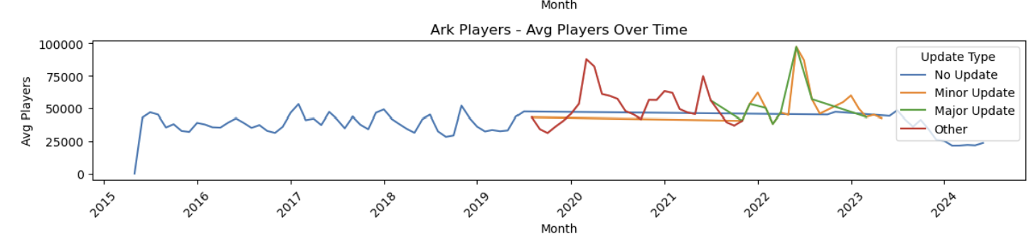
3) Visualization
Ark - Avg Players Over Time
The number of in-game players is relatively stable but decreasing. There is a huge spike in 2020, likely due to a major update. Like Isle, there are fewer players in 2022, most likely because of less frequent or less impactful updates.
Visual:
Line Plot: Shows average player count over time with marked spikes and general trend.

Slide 7
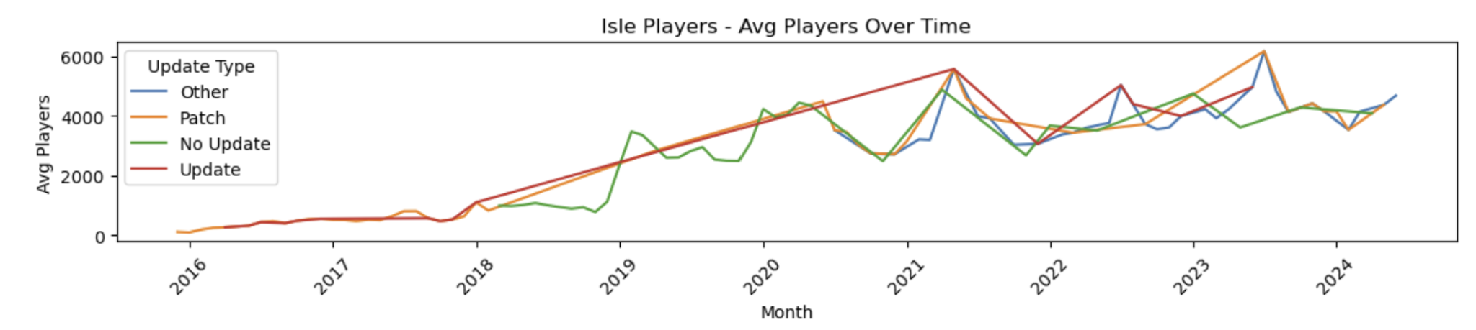
The Isle - Avg Players Over Time
The average number of players shows a general increasing trend. There is a big spike in players' count in 2021, which might be the date for the release of a bigger update of the game. Then the declining graph is seen in 2023, probably due to the failure of any big updates or content.
Visual:
Line Plot: Displays average player count over time with spikes and declines.

Slide 8
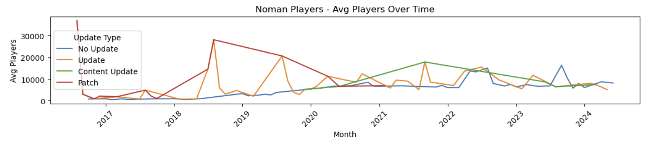
No Man's Sky - Avg Players Over Time
The game is on a downward trajectory, peaking in 2019, where there is a noticeable spike that is likely due to the effect of a major update. But with that slump in 2020, it's probably not well-maintained, with no updating going on for its player base.
Visual:
Line Plot: Shows average player count with peaks and subsequent declines.

Slide 9
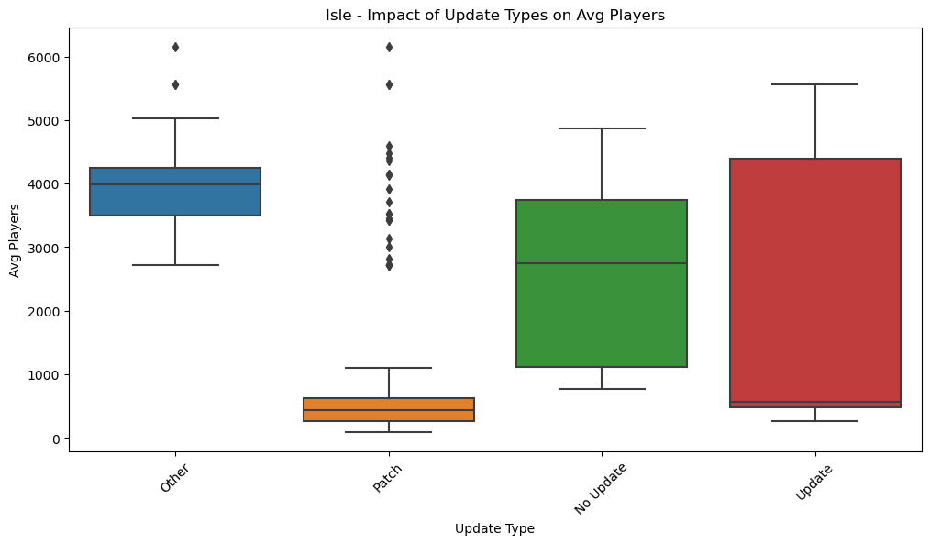
4) Analysis of Update Impact
The Isle:
Other: Average player count around 4000, with moderate variability and some spikes up to 6000 players.
Patch: Significant drop in average players, ranging from 0 to 1000, with large deviations up to 6000 players.
No Update: Wide range of average players from 1000 to 5000, indicating high variability.
Update: Highest average player count between 2000 and 5000, showing updates attract the most players.

Slide 10
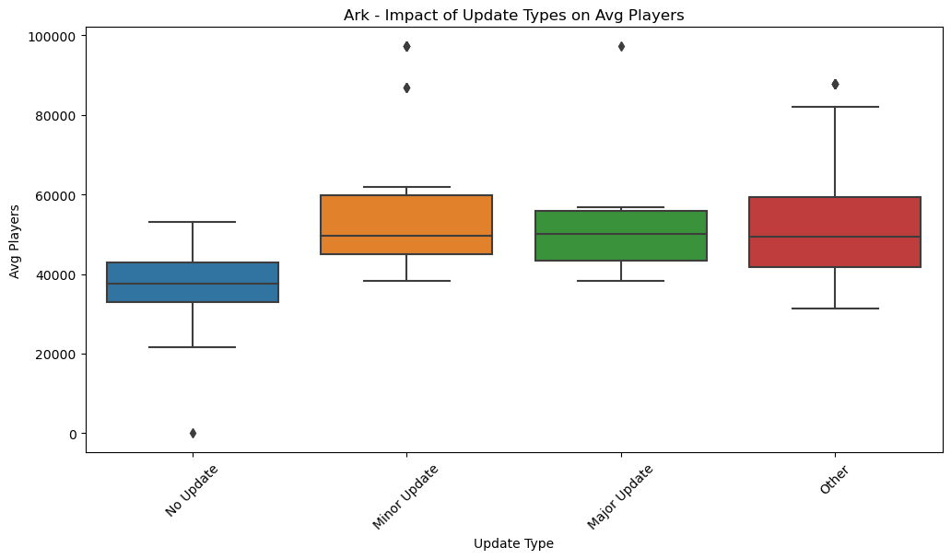
ARK: Survival Evolved:
No Update: Average player count around 4000, with occasional drops below 1000.
Minor Update: Higher player counts, averaging 4000 to 6000, suggesting minor updates are well-received.
Major Update: Similar average player counts to minor updates (4000 to 6000), indicating major updates are also effective.
Other: Highest average player counts from 3000 to 7000, suggesting "other" updates have strong impacts.

Slide 11
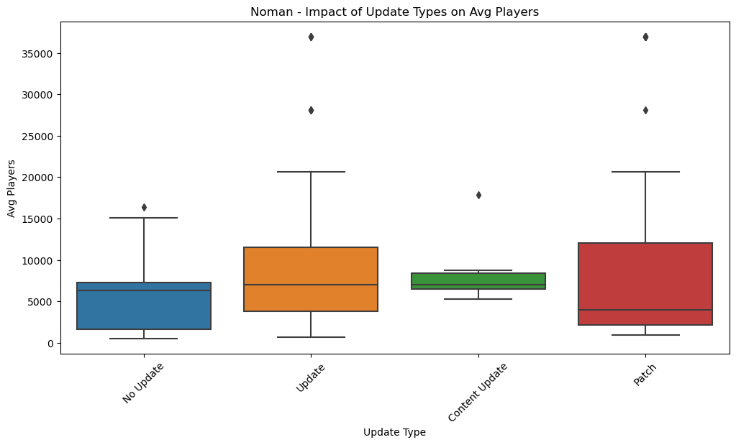
No Man's Sky:
No Update: Average player count around 7000, with some outliers below 1000.
Update: Higher average player count, ranging from 7000 to 12000, indicating strong player engagement.
Content Update: Lowest average player count among updates, from 5000 to 10000.
Patch: Highest variability, with average player counts from 2000 to 35000, showing patches can lead to significant increases but with high variability.

Slide 12
5) Questions to Investigate
1. High-Level Effect of Updates on Player Retention
Isle:
Major updates significantly boost player counts initially; effects last a few weeks before tapering.
Second week post-update typically shows stable retention.
ARK: Survival Evolved:
Major updates lead to increased player counts for a few weeks; magnitude varies with update type.
Player retention rises post-update but fluctuates more compared to "The Isle."
No Man's Sky:
Major updates result in sustained high player counts; effects last longer than other games.
Player retention spikes post-update and remains higher compared to other games.
2. Frequency of Updates and Player Activity
Isle:
Monthly updates maintain higher engagement; quarterly updates lead to activity drops.
Higher engagement between updates correlates with more frequent updates.
ARK: Survival Evolved:
Frequent updates retain more players and keep them active.
Higher engagement between updates indicates more frequent updates.
No Man's Sky:
Monthly updates ensure consistent activity; less frequent updates cause significant deviations.
Regular updates maintain high engagement and minimize activity lulls.

Slide 13
3. Types of Updates and Their Impact
Isle:
Content updates have the most significant impact on retention; bug fixes and balance changes are less effective.
ARK: Survival Evolved:
Content updates drive long-term engagement; bug fixes and balance changes help but have shorter-term effects.
No Man's Sky:
Content updates are crucial for retaining players long-term; consistent new content improves retention.
4. Cross-Comparison Across Multiple Games
Isle:
Typical increase in player retention post-update with a gradual decline; new content has a significant impact.
ARK: Survival Evolved:
Similar trends to "The Isle," with bursts in retention post-update; impact varies with update type and frequency.
No Man's Sky:
Gradual and sustained increase in player count post-update; benefits from continuous content delivery.
Effect of Update Regularity:
Isle: More frequent updates generally better for retention; less frequent updates cause larger engagement gaps.
ARK: Frequent updates help with retention; less frequent updates lead to more fluctuation.
No Man's Sky: Regular updates sustain steady player counts; infrequent updates lead to significant drops in activity.

Slide 14
Conclusion
Impact of Major Updates: Significant positive effect on player engagement across all games, with noticeable spikes in player counts following major updates.
Effectiveness of Update Types:
Content Updates: Most effective in boosting player numbers by introducing new features.
Balance Updates: Moderate impact, improving gameplay but less influential on engagement.
Bug Fixes: Minimal direct effect on player engagement, crucial for game stability.
Trends in Player Engagement:
Update Frequency: Regular updates keep player interest high; long gaps lead to declines in player numbers.
Update Timing: Consistent, meaningful updates are key to maintaining player retention.
Visualization & Data Handling: Effective use of line plots and boxplots for trend analysis; missing values addressed to ensure reliable insights.

Slide 15
References
GitHub Repository for data SikoticVinyl. (2024). Project1. Retrieved from https://github.com/SikoticVinyl/Project1.git

